Slide 1

Chapter 14
Strategies for Firm Growth
Bruce R. Barringer
R. Duane Ireland
Copyright ©2012 Pearson Education, Inc. publishing as Prentice Hall
14-<number>

Slide 2
Chapter Objectives
1 of 2
Explain the difference between internal growth strategies and external growth strategies.
Identify the keys to effective new product development.
Explain the common reasons new products fail.
Discuss a market penetration strategy.
Explain what an “international new venture” is and describe its importance to entrepreneurial firms.
Discuss the objectives a company can achieve by acquiring another business.
Copyright ©2012 Pearson Education, Inc. publishing as Prentice Hall
14-<number>

Slide 3
Chapter Objectives
2 of 2
Identify a promising acquisition candidate’s characteristics.
Explain “licensing” and how it can be used as a growth strategy.
Explain “strategic alliances” and describe the difference between technological alliances and marketing alliances.
Explain “joint ventures” and describe the difference between a scale joint venture and a link joint venture.
Copyright ©2012 Pearson Education, Inc. publishing as Prentice Hall
14-<number>

Slide 4
Internal and External Growth Strategies
1 of 2
Internal Growth Strategies
External Growth Strategies
Involve efforts taken within the firm itself, such as new product development, other product-related strategies, and international expansion
Rely on establishing relationships with third parties, such as mergers, acquisitions, strategic alliances, joint ventures, licensing, and franchising
Copyright ©2012 Pearson Education, Inc. publishing as Prentice Hall
14-<number>

Slide 5
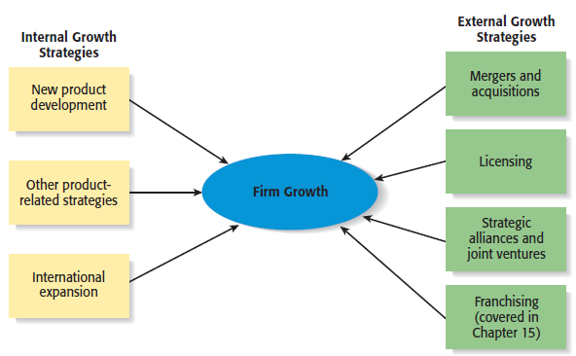
Internal and External Growth Strategies
2 of 2
Copyright ©2012 Pearson Education, Inc. publishing as Prentice Hall
14-<number>

Slide 6
Internal Growth Strategies
New product
development
Other product-
related strategies
International
expansion
Copyright ©2012 Pearson Education, Inc. publishing as Prentice Hall
14-<number>

Slide 7
Advantages and Disadvantages of Internal Growth Strategies
Advantages
Disadvantages
Incremental, even-paced growth
Provides maximum control
Preserves organizational culture
Encourages internal entrepreneurship
Allows firms to promote from within
Slow form of growth
Need to develop new resources
Investment in a failed internal growth
strategy can be difficult to recoup
Adds to industry capacity
Copyright ©2012 Pearson Education, Inc. publishing as Prentice Hall
14-<number>

Slide 8
New Product Development
1 of 3
New Product Development
  Involves the creation and sale of new products (or services) as a means of increasing firm revenues.
  In many fast-paced industries, new product development is a competitive necessity.
    For example, the average product life cycle in the computer software industry is 14 to 16 months.
Copyright ©2012 Pearson Education, Inc. publishing as Prentice Hall
14-<number>

Slide 9
New Product Development
2 of 3
Keys to Effective New Product and Service Development
Find a niche and fill it.
Develop products that add value.
Get quality right and pricing right.
Focus on a specific target market.
Conduct ongoing feasibility analysis.
Copyright ©2012 Pearson Education, Inc. publishing as Prentice Hall
14-<number>

Slide 10
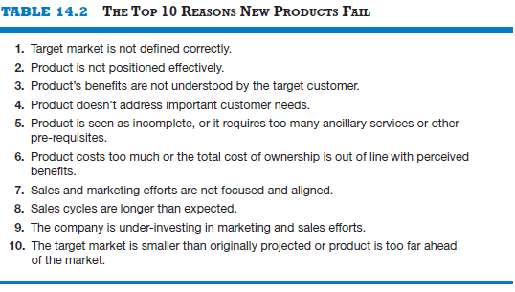
New Product Development
3 of 3
Copyright ©2012 Pearson Education, Inc. publishing as Prentice Hall
14-<number>

Slide 11
Other Product-Related Strategies
1 of 2
Product Strategy
Description
Improving an Existing Product or Service
Often a business can increase its revenues by simply increasing the quality of an existing product or service.
Increasing Market Penetration
Increasing the sales of a product or service through greater marketing efforts or through increased production capacity.
Copyright ©2012 Pearson Education, Inc. publishing as Prentice Hall
14-<number>

Slide 12
Other Product-Related Strategies
2 of 2
Product Strategy
Description
Extending Product Lines
Making additional variations of a product so it will appeal to a broader range of clientele
Geographic Expansion
Growth via expanding to additional geographic locations
Copyright ©2012 Pearson Education, Inc. publishing as Prentice Hall
14-<number>

Slide 13
International Expansion
1 of 3
International Expansion
  Another common form of growth for entrepreneurial firms.
  International new ventures are businesses that, from their inception, seek to derive significant competitive advantage by using their resources to sell products or services in multiple countries.
  Although there is vast potential associated with selling overseas, it is a fairly complex form of growth.
Copyright ©2012 Pearson Education, Inc. publishing as Prentice Hall
14-<number>

Slide 14
International Expansion
2 of 3
Foreign-Market Entry Strategies
  Exporting
    Producing a product at home and shipping it to a foreign market.
  Licensing
    An arrangement whereby a firm with the proprietary rights to a product grants permission to another firm to manufacture that product for specified royalties or other payments.
  Joint Ventures
    Involves the establishment of a firm that is jointly owned by two or more otherwise independent firms.
      Fuji-Xerox is a joint venture between an American and a Japanese company.
Copyright ©2012 Pearson Education, Inc. publishing as Prentice Hall
14-<number>

Slide 15
International Expansion
3 of 3
Foreign-Market Entry Strategies
  Franchising
    An agreement between a franchisor (a company like McDonald’s Inc., that has an established business method and brand) and a franchisee (the owner of one or more McDonald’s restaurants).
  Turnkey Project
    A contractor from one country builds a facility in another country, trains the personnel that will operate the facility, and turns over the keys to the project when it is completed and ready to operate.
  Wholly Owned Subsidiary
    A company that has made the decision to manufacture a product in a foreign country and establish a permanent presence.
Copyright ©2012 Pearson Education, Inc. publishing as Prentice Hall
14-<number>

Slide 16
External Growth Strategies
Mergers and
Acquisitions
Licensing
Strategic Alliances
and Joint Ventures
Franchising
(Chapter 15)
Copyright ©2012 Pearson Education, Inc. publishing as Prentice Hall
14-<number>

Slide 17
Advantages and Disadvantages of External Growth Strategies
Advantages
Disadvantages
Reducing competition
Gaining access to proprietary
products or services
Gaining access to new products
and markets
Obtaining access to technical expertise
Gaining access to an established
brand name
Economies of scale
Diversification of business risk
Incompatibility of top management
Clash of corporate cultures
Operational problems
Increased business complexity
Loss of organizational flexibility
Antitrust implications
Copyright ©2012 Pearson Education, Inc. publishing as Prentice Hall
14-<number>

Slide 18
Mergers and Acquisitions
Mergers and Acquisitions
  An acquisition is the outright purchase of one firm by another.
  A merger is the pooling of interests to combine two or more firms into one.
Purpose of Acquisitions
  Acquiring another business can fulfill several of a company’s needs, such as:
    Expanding its product line
    Gaining access to distribution channels
    Achieving competitive economies of scale
Copyright ©2012 Pearson Education, Inc. publishing as Prentice Hall
14-<number>

Slide 19
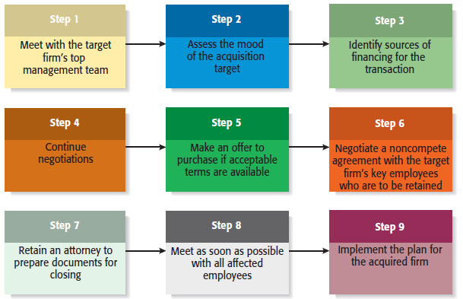
The Process of Completing an Acquisition
Copyright ©2012 Pearson Education, Inc. publishing as Prentice Hall
14-<number>

Slide 20
Licensing
1 of 3
Licensing
  The granting of permission by one company to another company to use a specific form of its intellectual property under clearly defined conditions.
  Virtually any intellectual property a company owns that is protected by a patent, trademark, or copyright can be licensed to a third party.
Licensing Agreement
  The terms of a license are spelled out by a licensing agreement.
Copyright ©2012 Pearson Education, Inc. publishing as Prentice Hall
14-<number>

Slide 21
Licensing
2 of 3
Type of Licensing
Description
Technology Licensing
The licensing of proprietary technology that the licensor typically controls by virtue of a utility patent.
Merchandise and Character Licensing
The licensing of a recognized trademark or brand that the licensor typically controls through a trademark or copyright.
Copyright ©2012 Pearson Education, Inc. publishing as Prentice Hall
14-<number>

Slide 22

Licensing
3 of 3
Character licensing, for example,
represented a major source of
revenue for Pixar in its early
years.
Popular characters, like Marlin
and Dory from Finding Nemo,
adorn products as diverse as
dinner plates and sleeping bags.
Copyright ©2012 Pearson Education, Inc. publishing as Prentice Hall
14-<number>

Slide 23
Strategic Alliances
1 of 2
Strategic Alliances
  A strategic alliance is a partnership between two or more firms developed to achieve a specific goal.
  Strategic alliances tend to be informal and do not involve the creation of a new entity.
  Participating in strategic alliances can boost a firm’s rate of product innovation and foreign sales.
Copyright ©2012 Pearson Education, Inc. publishing as Prentice Hall
14-<number>

Slide 24
Strategic Alliances
2 of 2
Type of Alliance
Description
Technological Alliances
Feature cooperation in R&D, engineering, and manufacturing
Marketing Alliances
Typically match a company with excess distribution capacity with a company that has a product to sell
Copyright ©2012 Pearson Education, Inc. publishing as Prentice Hall
14-<number>

Slide 25
Joint Ventures
1 of 2
Joint Ventures
  A joint venture is an entity created when two or more firms pool a portion of their resources to create a separate, jointly owned organization.
  A common reason to form a joint venture is to gain access to a foreign market. In these cases, the joint venture typically consists of the firm trying to reach a foreign market and one or more local partners.
Copyright ©2012 Pearson Education, Inc. publishing as Prentice Hall
14-<number>

Slide 26
Joint Ventures
2 of 2
Type of Joint Venture
Description
Partners collaborate at a single point in the value chain to gain economies of scale in production or distribution.
Scale Joint Venture
Positions of the partners are not symmetrical, and the partners help each other access adjacent links in the value chain.
Link Joint Venture
Copyright ©2012 Pearson Education, Inc. publishing as Prentice Hall
14-<number>

Slide 27
Advantages and Disadvantages of Participating in Strategic Alliances and Joint Ventures
Advantages
Disadvantages
Gain access to a specific resource
Economies of scale
Risk and cost sharing
Gain access to a foreign market
Learning
Speed to market
Neutralizing or blocking
competitors
Loss of proprietary information
Management complexities
Financial and organizational risks
Risk becoming dependent on a partner
Partial loss of decision autonomy
Partners’ cultures may clash
Loss of organizational flexibility
Copyright ©2012 Pearson Education, Inc. publishing as Prentice Hall
14-<number>

Slide 28

All rights reserved. No part of this publication may be reproduced, stored in a retrieval system, or transmitted, in any form or by any means, electronic, mechanical, photocopying, recording, or otherwise, without the prior written permission of the publisher. Printed in the United States of America.
Copyright ©2012 Pearson Education, Inc. publishing as Prentice Hall
Copyright ©2012 Pearson Education, Inc. publishing as Prentice Hall
14-<number>

